Slide 1

DSN2098 – PROJECT EXHIBITION-1 CUSTOMER SEGMENTATION REVIEW-3
GUIDE – DR. PON HARSHAVARDHANAN

Slide 2

GROUP MEMBERS-
HARSH KAKAIYA ( 20MIP10007 )
SOUMYADEV KUNDU ( 20MIP10011 )
VIVEK KUMAR ( 20MIP10016 )
SHREYASH JAISWAL ( 20MIP10046 )
SAMBHAV JAIN ( 20MIP10050 )

Slide 3

OUTLINE-
Introduction
Existing Work with Limitations
Proposal
Real Time Usage
Literature Review
Software Requirements
System Architecture Diagram
Module Split-Up and Explanation
Snap-Shot
Result and Discussion (Input and output)
References
Conclusion

Slide 4
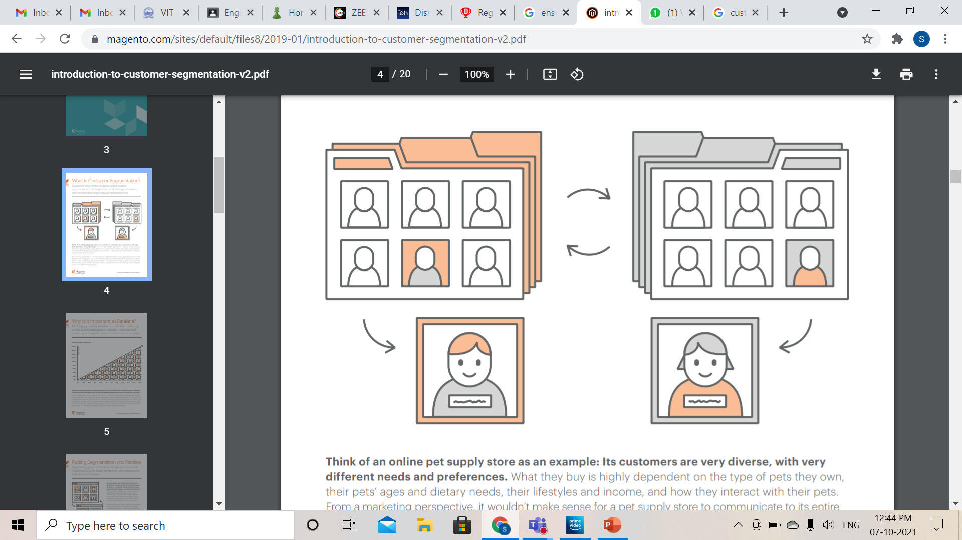
INTRODUCTION-
Customer Segmentation ( also called Market Segmentation ) is
the practice of dividing customers into groups that share
similar characteristics.
1. Renewing our Understanding
2. Profiting through Segmentation

Slide 5

3. Investing to Action through Segmentation
4. Making it Happen

Slide 6
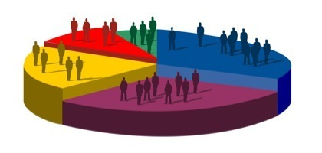
EXISTING WORK WITH LIMITATIONS-
Limited Production
Expensive Production
Difficulty in Distribution
Heavy Investment
Promotion Problems

Slide 7
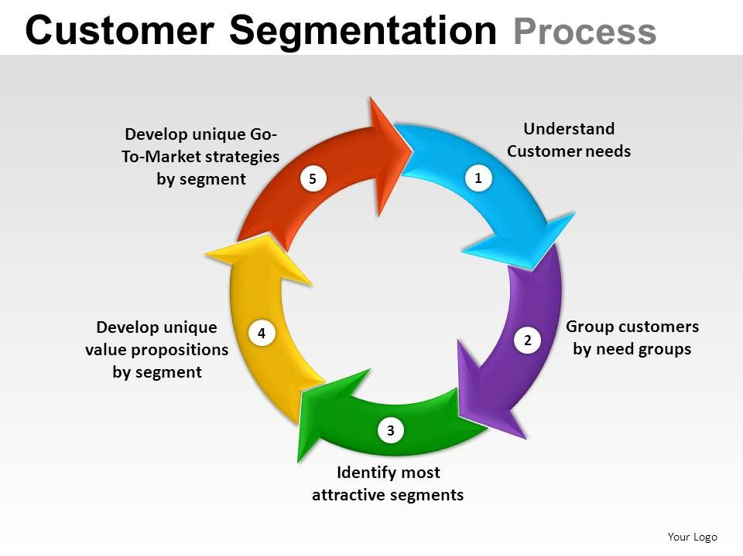
PROPOSAL-
Import packages and data
Data Cleaning
Normalize the data
Elbow Criterion Method
Performing EDA on the data
Ensembled Learning

Slide 8

REAL TIME USAGE-
Re-Marketing
Personalization
Conversion Optimization
Customer Support
Use Scoring

Slide 9
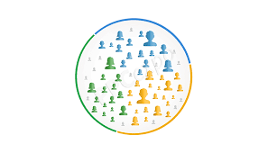
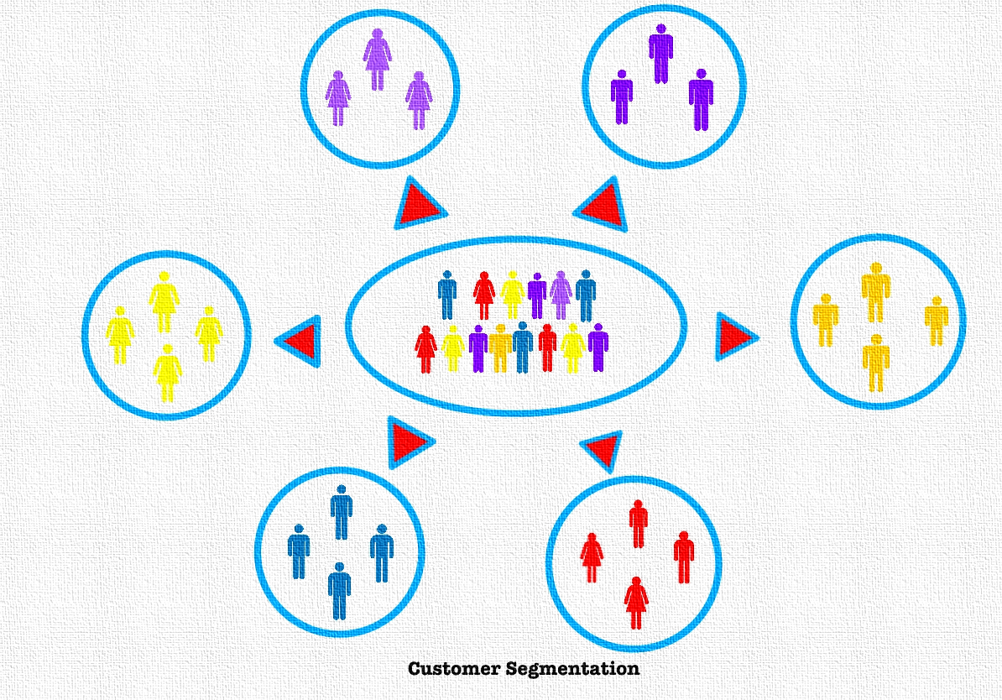
LITERATURE REVIEW-
Customer Classification
Data Repository
Clustering Data
K-mean

Slide 10
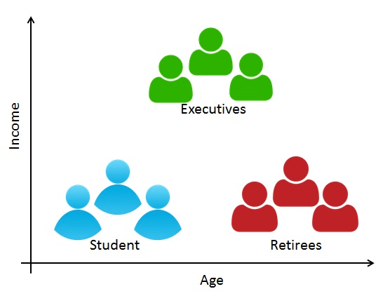
SOFTWARE REQUIREMENTS-
PYTHON
MATPLOTLIB
SEABORN
NUMPY
PANDAS
MAS EXCEL
SCIKITLERAN

Slide 11
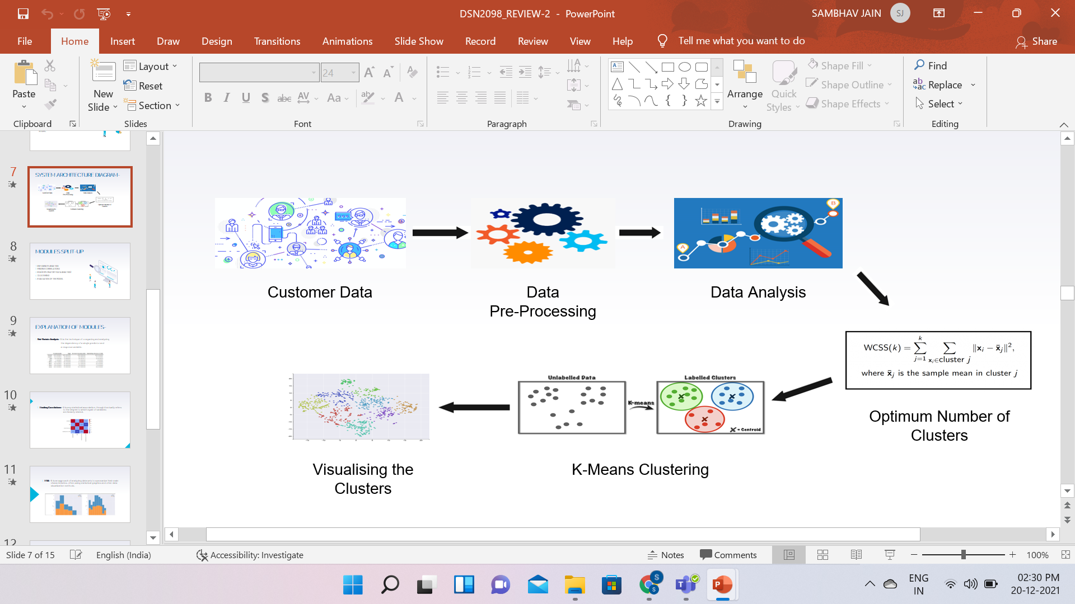
SYSTEM ARCHITECTURE DIAGRAM-

Slide 12
MODULES SPLIT-UP
UNI-VARIATE ANALYSIS
FINDING CORRELATIONS
EDA ( EXPLONATORY DATA ANALYSIS )
CLUSTERING
EVALUATION OF THE MODEL

Slide 13
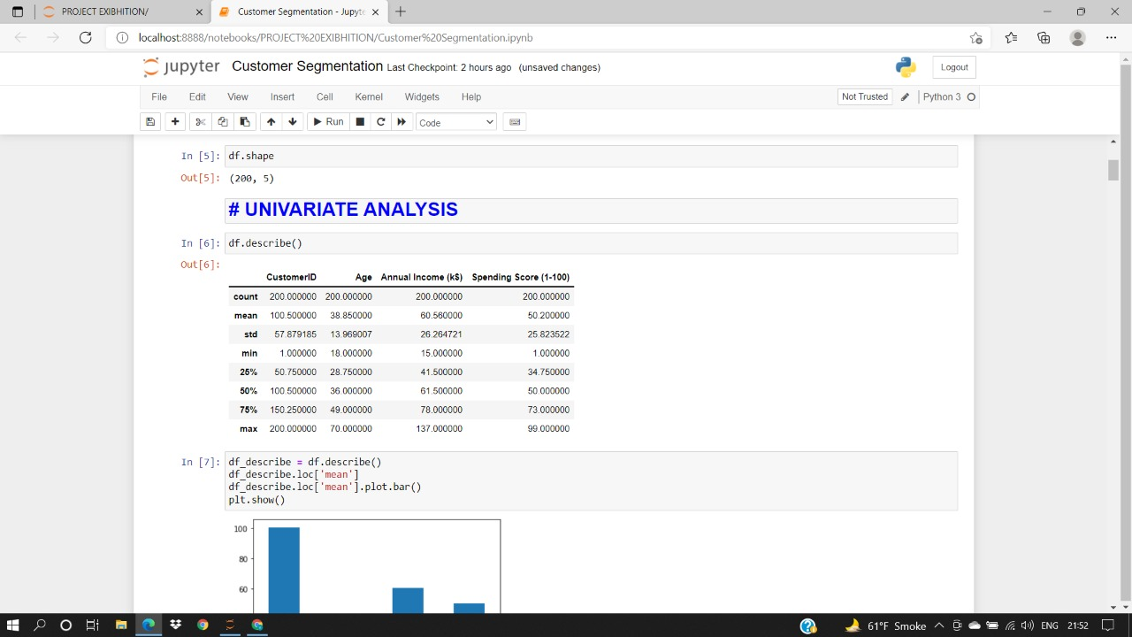
EXPLANATION OF MODULES-
1. Uni-Variate Analysis - It is the technique of comparing and analyzing the
dependency of a single predictor and a response
variable.

Slide 14
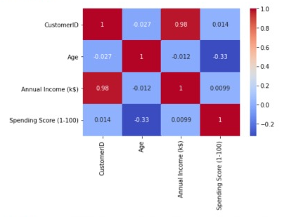
2. Finding Correlations – It is any statistical association, though it actually
refers to the degree to which a pair of variables
are linearly related.

Slide 15
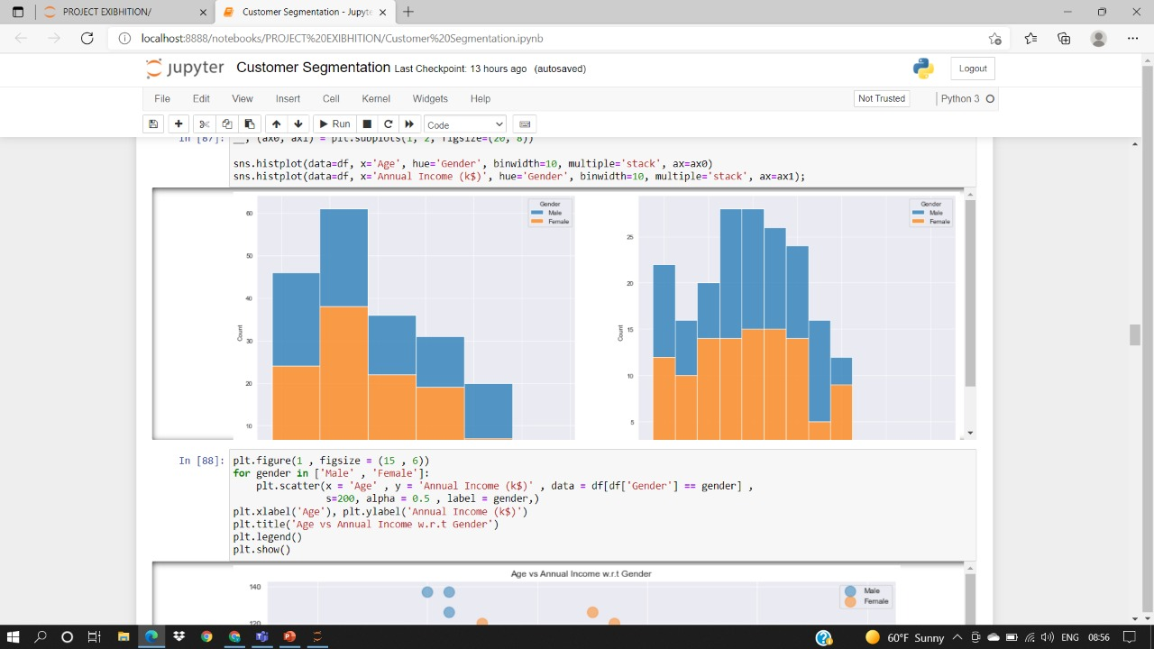
3. EDA – It is an approach of analyzing data sets to summarize their main characteristics, often using statistical graphics and other data visualization methods.

Slide 16
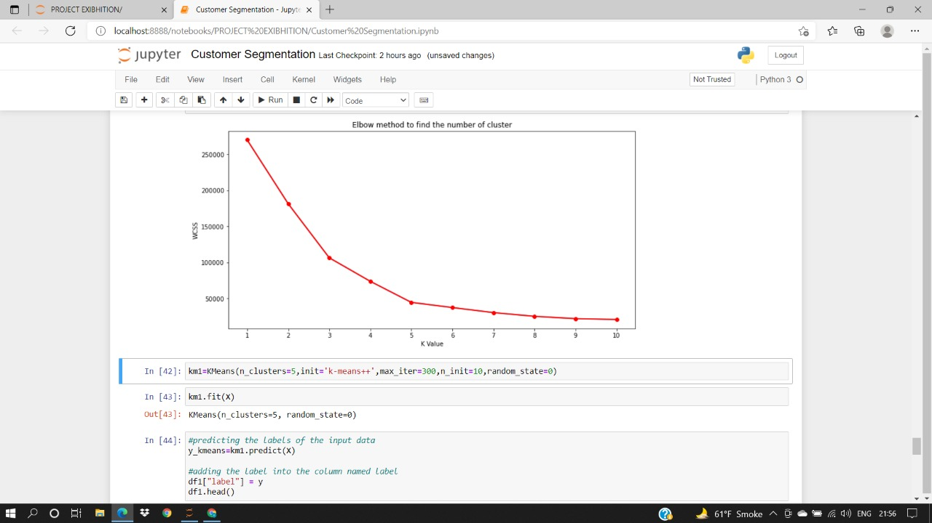
4. Clustering – It is the task of dividing the population or data points into a number of groups such that data points in the same groups are more similar to other data points in the same group than those in other groups.

Slide 17
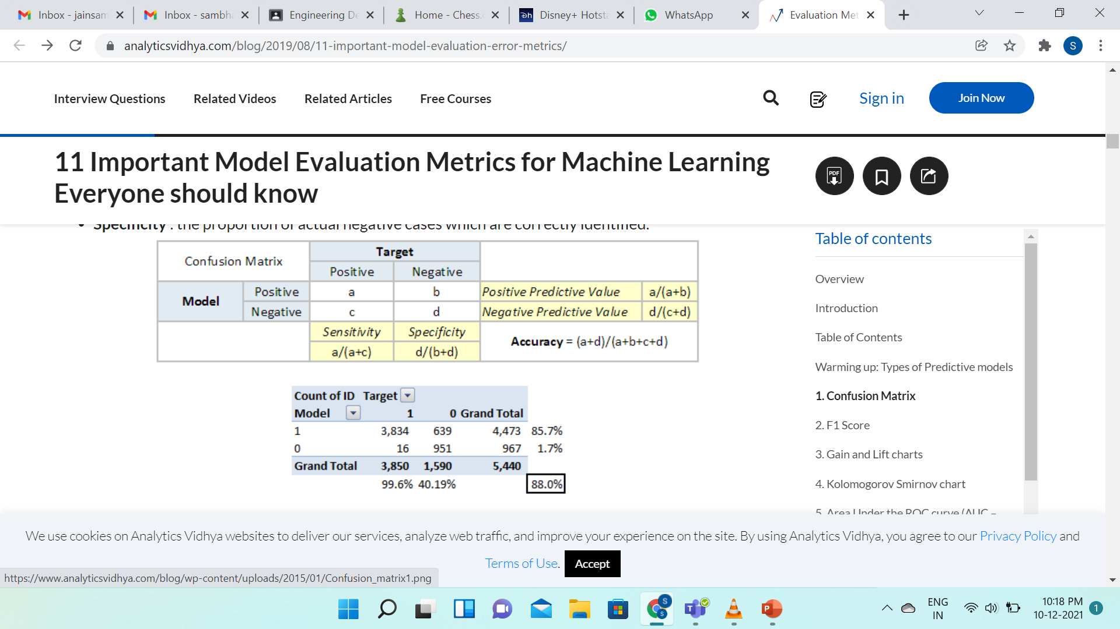
5. Evaluation of the Model - Model Evaluation is the subsidiary part of the model development process. It is the phase that is decided whether the model performs better. Therefore, it is critical to consider the model outcomes according to every possible evaluation method. Applying different methods can provide different perspectives.

Slide 18
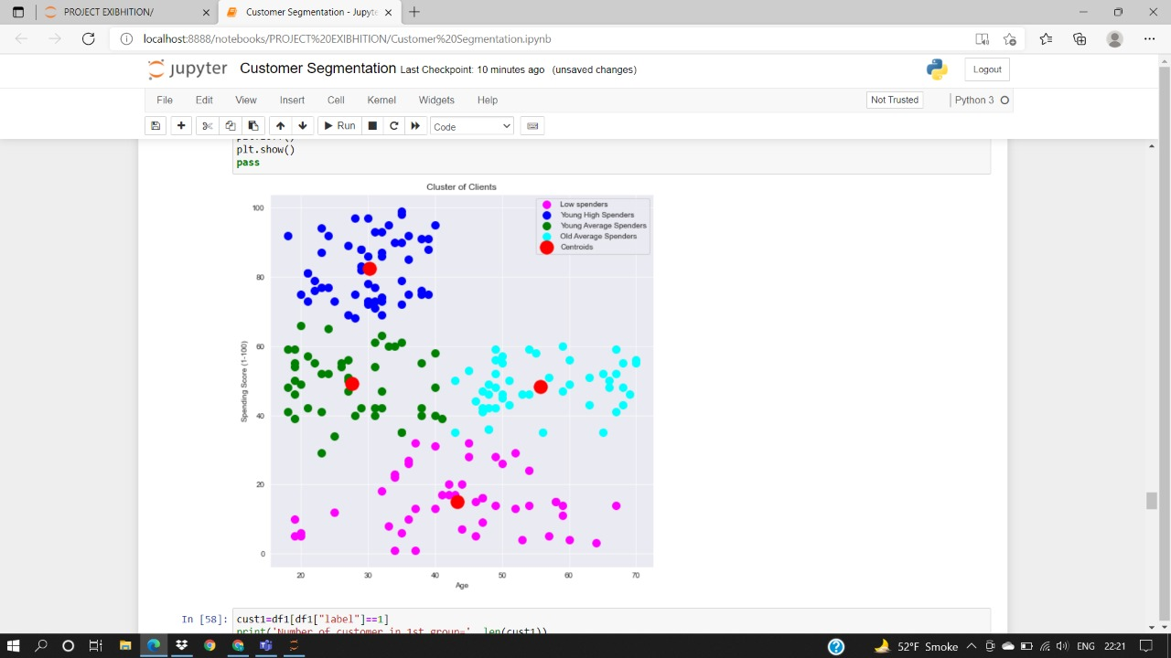
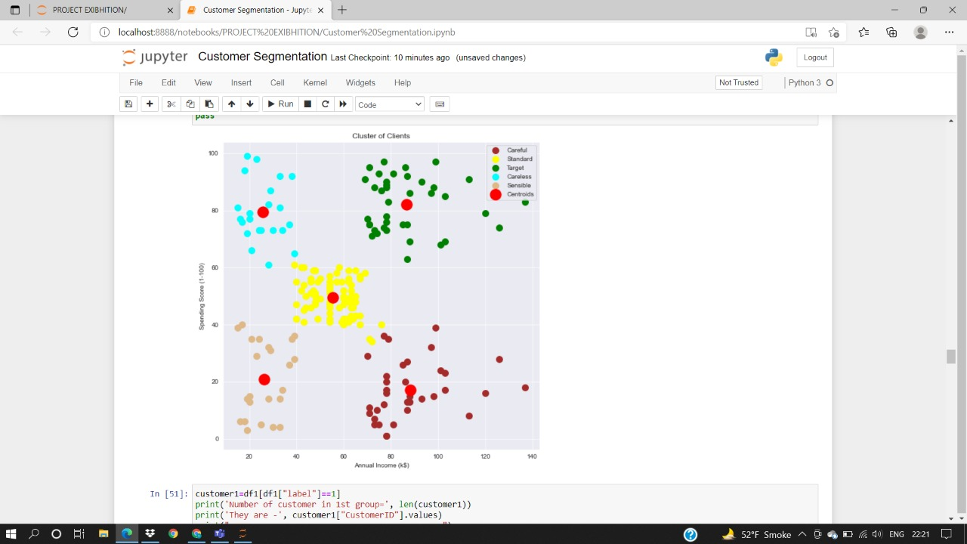
SNAPSHOT-

Slide 19
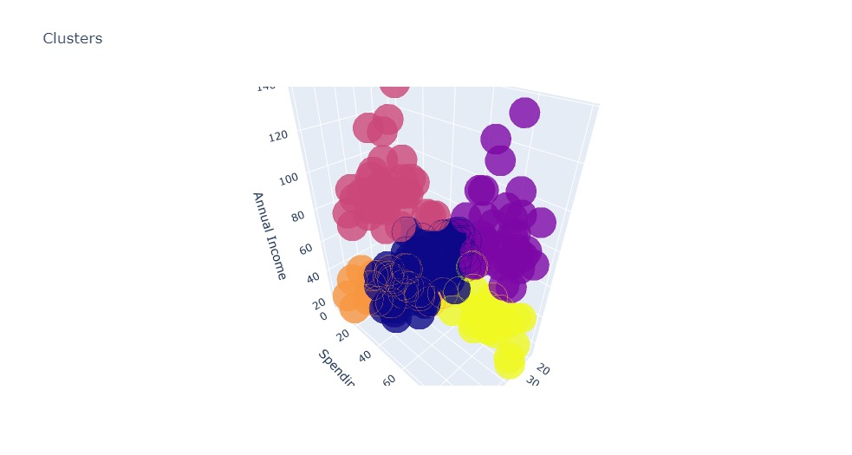
RESULT AND DISCUSSION-
This is the 3d scatter plot for the Annual Income vs Spending Score. We chose 3d scatter plot not just for aesthetics but for looking at the minute details of the plot to understand the dataset properly and where the actual clusters are forming in the plot which is not very clear inside a 2d scatter plot.

Slide 20

REFERENCES-
https://www.researchgate.net/publication/316090145_Big_Data_Analytics_Based_Recommender_System_for_Value_Added_Services_VAS
https://en.wikipedia.org/wiki/Market_segmentation
https://www.analyticsvidhya.com/blog/2021/01/in-depth-intuition-of-k-means-clustering-algorithm-in-machine-learning/
https://docs.treasuredata.com/display/public/PD/Real-Time+Segmentation
https://magento.com/sites/default/files8/2019-01/introduction-to-customer-segmentation-v2.pdf

Slide 21

CONCLUSION-
Customer Segmentation is separating a market into distinct groups of potential consumers who share common characteristics and interests and who are likely to be attracted to particular products or services. Segmentation allows you to develop products and plans which fit the needs of customers more efficiently. It is a marketing approach that encompasses the identification of different groups of customers with different needs or responses to marketing activity. This process also considers which of these segments to target.

Slide 22
